Slide 1
Chapter 2 Arrays & Structures

Slide 2
Outline
1-dimension array addressing
Implementation structure and unions
Polynomial Addition - data structure 2
Transpose matrix
Fast transpose matrix
Sparse Matrix Multiplication

Slide 3
1-dimension array addressing
回outline
目的: 顯示一個陣列的address和value
int main(void) {
int one[] = {0, 1, 2, 3, 4};
print1(&one[0], 5);
}
void print1(int *ptr, int rows){
int i;
printf("Address Contents\n");
for(i = 0;i < rows;i++){
printf("%08u %5d\n", ptr+i, *(ptr+i));
}
}
宣告一個陣列並給予值

Slide 4
1-dimension array addressing
目的: 顯示一個陣列的address和value
int main(void) {
int one[] = {0, 1, 2, 3, 4};
print1(&one[0], 5);
}
void print1(int *ptr, int rows){
int i;
printf("Address Contents\n");
for(i = 0;i < rows;i++){
printf("%08u %5d\n", ptr+i, *(ptr+i));
}
}
陣列one的長度
陣列one的索引值為0
取address

Slide 5
1-dimension array addressing
目的: 顯示一個陣列的address和value
int main(void) {
int one[] = {0, 1, 2, 3, 4};
print1(&one[0], 5);
}
void print1(int *ptr, int rows){
int i;
printf("Address Contents\n");
for(i = 0;i < rows;i++){
printf("%08u %5d\n", ptr+i, *(ptr+i));
}
}
八位數的無符號十進位整數，不足以0填滿

Slide 6
1-dimension array addressing
目的: 顯示一個陣列的address和value
int main(void) {
int one[] = {0, 1, 2, 3, 4};
print1(&one[0], 5);
}
void print1(int *ptr, int rows){
int i;
printf("Address Contents\n");
for(i = 0;i < rows;i++){
printf("%08u %5d\n", ptr+i, *(ptr+i));
}
}
五位數的有符號十進位整數，不足以空白填滿

Slide 7
1-dimension array addressing
目的: 顯示一個陣列的address和value
int main(void) {
int one[] = {0, 1, 2, 3, 4};
print1(&one[0], 5);
}
索引值
0
1
2
3
4
address
06422284
06422288
06422292
06422296
06422300
one
0
1
2
3
4
* 每個int是4 bytes，所以address之間的間隔差4

Slide 8
1-dimension array addressing
目的: 顯示一個陣列的address和value
void print1(int *ptr, int rows){
int i;
printf("Address Contents\n");
for(i = 0;i < rows;i++){
printf("%08u %5d\n", ptr+i, *(ptr+i));
}
}
索引值
0
1
2
3
4
Output:
Address Contents
06422284 0
address
06422284
06422288
06422292
06422296
06422300
ptr+0
i = 0
one
0
1
2
3
4
*(ptr+0)

Slide 9
1-dimension array addressing
目的: 顯示一個陣列的address和value
void print1(int *ptr, int rows){
int i;
printf("Address Contents\n");
for(i = 0;i < rows;i++){
printf("%08u %5d\n", ptr+i, *(ptr+i));
}
}
索引值
0
1
2
3
4
Output:
Address Contents
06422284 0
06422288 1
address
06422284
06422288
06422292
06422296
06422300
ptr+1
i = 1
one
0
1
2
3
4
*(ptr+1)

Slide 10
1-dimension array addressing
目的: 顯示一個陣列的address和value
void print1(int *ptr, int rows){
int i;
printf("Address Contents\n");
for(i = 0;i < rows;i++){
printf("%08u %5d\n", ptr+i, *(ptr+i));
}
}
索引值
0
1
2
3
4
Output:
Address Contents
06422284 0
06422288 1
06422292 2
address
06422284
06422288
06422292
06422296
06422300
ptr+2
i = 2
one
0
1
2
3
4
*(ptr+2)

Slide 11
1-dimension array addressing
目的: 顯示一個陣列的address和value
void print1(int *ptr, int rows){
int i;
printf("Address Contents\n");
for(i = 0;i < rows;i++){
printf("%08u %5d\n", ptr+i, *(ptr+i));
}
}
索引值
0
1
2
3
4
Output:
Address Contents
06422284 0
06422288 1
06422292 2
06422296 3
address
06422284
06422288
06422292
06422296
06422300
ptr+3
i = 3
one
0
1
2
3
4
*(ptr+3)

Slide 12
1-dimension array addressing
回outline
目的: 顯示一個陣列的address和value
void print1(int *ptr, int rows){
int i;
printf("Address Contents\n");
for(i = 0;i < rows;i++){
printf("%08u %5d\n", ptr+i, *(ptr+i));
}
}
索引值
0
1
2
3
4
Output:
Address Contents
06422284 0
06422288 1
06422292 2
06422296 3
06422300 4
address
06422284
06422288
06422292
06422296
06422300
ptr+4
i = 4
one
0
1
2
3
4
*(ptr+4)

Slide 13
Implementation structure and unions
回outline
目的: 實作structure 和 unions
typedef struct {
enum {female, male} sex;
union {
int children;
int beard;
} u;
} sex_type;
typedef struct {
char name[10];
int age;
float salary;
sex_type sex_info;
} human_being;
列舉(Enumeration)是以關鍵字enum開始加上一個列舉名稱，並以大括號括住要群組管理的常數。

Slide 14
Implementation structure and unions
說明階層關係
typedef struct {
enum {female, male} sex;
union {
int children;
int beard;
} u;
} sex_type;
typedef struct {
char name[10];
int age;
float salary;
sex_type sex_info;
} human_being;
human_being -> name
-> age
-> salary
->型別為結構sex_type的sex_info -> sex
-> u -> children
-> beard

Slide 15
Implementation structure and unions
說明階層關係
typedef struct {
enum {female, male} sex;
union {
int children;
int beard;
} u;
} sex_type;
typedef struct {
char name[10];
int age;
float salary;
sex_type sex_info;
} human_being;
human_being -> name
-> age
-> salary
->型別為結構sex_type的sex_info -> sex
-> u -> children
-> beard

Slide 16
Implementation structure and unions
說明階層關係
typedef struct {
enum {female, male} sex;
union {
int children;
int beard;
} u;
} sex_type;
typedef struct {
char name[10];
int age;
float salary;
sex_type sex_info;
} human_being;
human_being -> name
-> age
-> salary
-> sex_type -> sex
-> u -> children
-> beard

Slide 17
Implementation structure and unions
說明階層關係
typedef struct {
enum {female, male} sex;
union {
int children;
int beard;
} u;
} sex_type;
typedef struct {
char name[10];
int age;
float salary;
sex_type sex_info;
} human_being;
human_being -> name
-> age
-> salary
->型別為結構sex_type的sex_info -> sex
-> u -> children
-> beard

Slide 18
Implementation structure and unions
說明階層關係
typedef struct {
enum {female, male} sex;
union {
int children;
int beard;
} u;
} sex_type;
typedef struct {
char name[10];
int age;
float salary;
sex_type sex_info;
} human_being;
human_being -> name
-> age
-> salary
->型別為結構sex_type的sex_info -> sex
-> u -> children
-> beard

Slide 19
Implementation structure and unions
說明階層關係
typedef struct {
enum {female, male} sex;
union {
int children;
int beard;
} u;
} sex_type;
typedef struct {
char name[10];
int age;
float salary;
sex_type sex_info;
} human_being;
human_being -> name
-> age
-> salary
->型別為結構sex_type的sex_info -> sex
-> u -> children
-> beard

Slide 20
Implementation structure and unions
說明階層關係
typedef struct {
enum {female, male} sex;
union {
int children;
int beard;
} u;
} sex_type;
typedef struct {
char name[10];
int age;
float salary;
sex_type sex_info;
} human_being;
human_being -> name
-> age
-> salary
->型別為結構sex_type的sex_info -> sex
-> u -> children
-> beard

Slide 21
Implementation structure and unions
說明階層關係
typedef struct {
enum {female, male} sex;
union {
int children;
int beard;
} u;
} sex_type;
typedef struct {
char name[10];
int age;
float salary;
sex_type sex_info;
} human_being;
human_being -> name
-> age
-> salary
->型別為結構sex_type的sex_info -> sex
-> u -> children
-> beard

Slide 22
Implementation structure and unions
回outline
階層關係轉換成程式碼
human_being person1;
human_being -> name
-> age
-> salary
->型別為結構sex_type的sex_info -> sex
-> u -> children
-> beard
person1 -> person1.name
-> person1.age
-> person1.salary
-> person1.sex_info -> person1.sex_info.sex
-> person1.sex_info.u -> person1.sex_info.u.children
-> person1.sex_info.u.beard

Slide 23
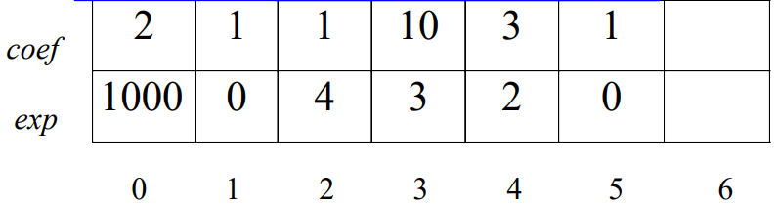



Polynomial Addition - data structure 2
回outline
目的: 將方程式A(X)和方程式B(X)相加
作法說明:
$$A(X)=2X^{1000}+1$$
$$B\left(X\right)=X^{4}+10X^{3}+3X^{2}+1$$
startA
finishA
startB
finishB
avail
initial startA = 0
finishA = 1
startB = 2
finishB = 5
avail = 6
$$A(X)$$
$$B(X)$$

Slide 24
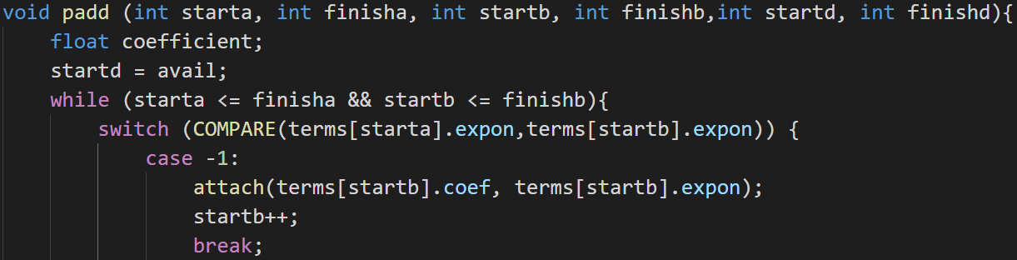
Polynomial Addition - data structure 2
目的: 將方程式A(X)和方程式B(X)相加
padd()程式碼說明:
avail是D(X)的開始位置
#define COMPARE(x, y) ((x < y) ? -1: (x == y)? 0: 1)
a 的 expon < b 的 expon : case -1
如果方程式A的次方<方程式B的次方成立，則放入D(X)

Slide 25
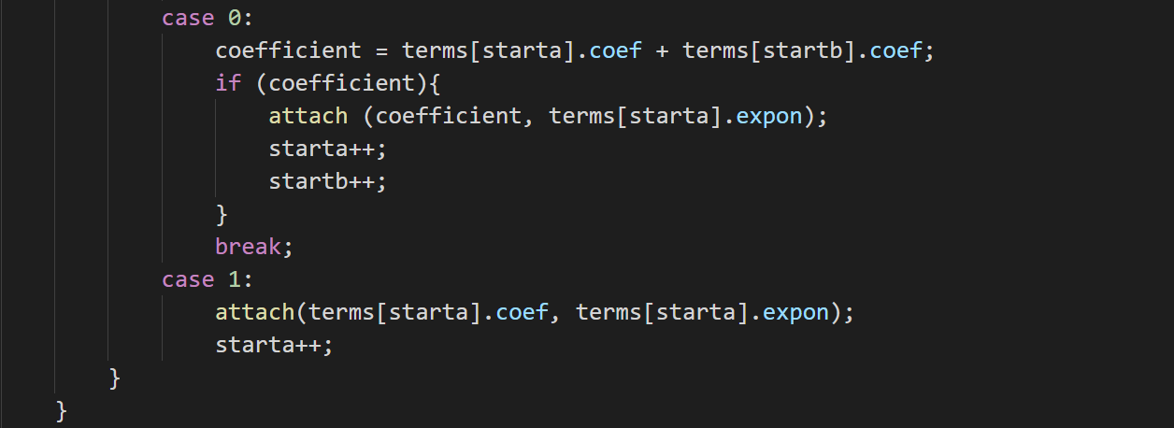
Polynomial Addition - data structure 2
目的: 將方程式A(X)和方程式B(X)相加
#define COMPARE(x, y) ((x < y) ? -1: (x == y)? 0: 1)
a 的 expon = b 的 expon : case 0
把兩方程式項目的係數相加且相加後係數不為0則放入D(X)
a 的 expon > b 的 expon : case 1
如果方程式A的次方>方程式B的次方成立，則放入D(X)

Slide 26
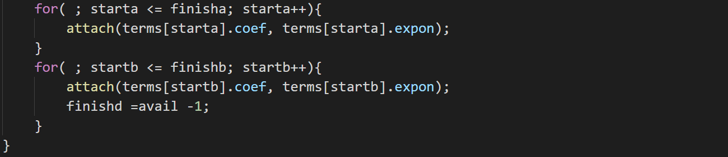
Polynomial Addition - data structure 2
目的: 將方程式A(X)和方程式B(X)相加
第一個for loop
如果方程式B已經結束時，將方程式A剩下的項目放進D(X)
第二個for loop
如果方程式A已經結束時，將方程式B剩下的項目放進D(X)

Slide 27
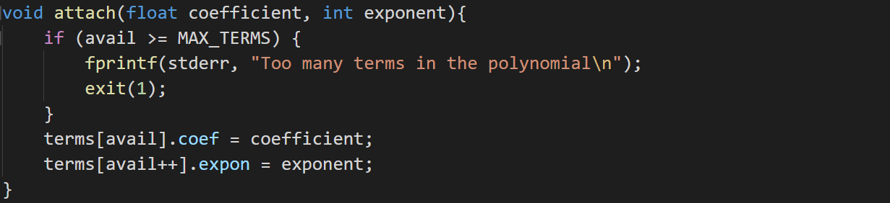
Polynomial Addition - data structure 2
回outline
目的: 將方程式A(X)和方程式B(X)相加
attach()程式碼說明:
如果沒有超過陣列最達長度，則將項目的指數及係數放到D(X)中

Slide 28
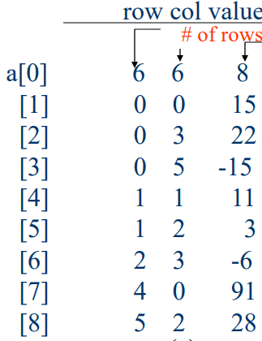
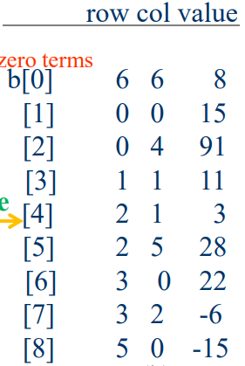
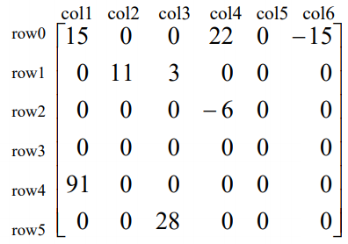
Transpose matrix
回outline
目的: 實作轉置矩陣
作法說明:
6 6 8
transpose
a[0] 儲存轉置前矩陣的基本資料，這是一個6*6的二維陣列，有8個非0的項目
a[0]以外的儲存轉置前矩陣中非0項目的位置(row, col)及其值(value)
b[0] 儲存轉置後矩陣的基本資料，這是一個6*6的二維陣列，有8個非0的項目
b[0]以外的儲存轉置後矩陣中非0項目的位置(row, col)及其值(value)

Slide 29
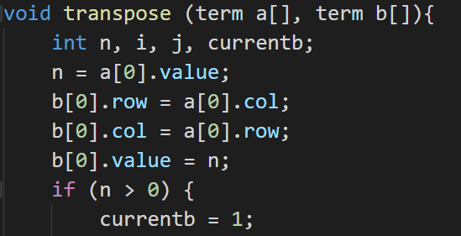
Transpose matrix
目的: 實作轉置矩陣
transpose()程式碼說明:
矩陣中非0項目
紀錄轉置後的矩陣，從位置1開始，位置0紀錄矩陣的基本資料
透過a[0]的基本資料，知道轉置後的資本資料。
row, col: a的col轉置後是b的row
a的row轉置後是b的col
value: 轉置後的非0項目數量不變

Slide 30
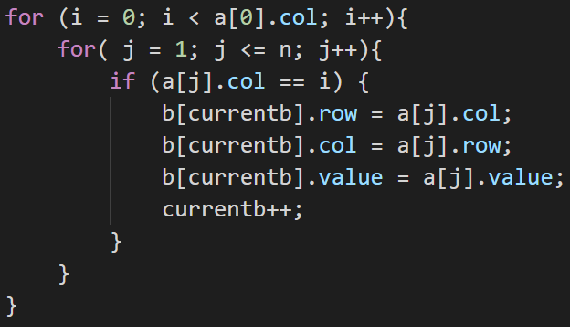
Transpose matrix
目的: 實作轉置矩陣
transpose()程式碼說明:
i = 0
6 6 8
j = 1

Slide 31
Transpose matrix
目的: 實作轉置矩陣
transpose()程式碼說明:
i = 0
6 6 8
j = 2

Slide 32
Transpose matrix
目的: 實作轉置矩陣
transpose()程式碼說明:
i = 0
6 6 8
j = 3

Slide 33
Transpose matrix
目的: 實作轉置矩陣
transpose()程式碼說明:
i = 0
6 6 8
j = 4

Slide 34
Transpose matrix
目的: 實作轉置矩陣
transpose()程式碼說明:
i = 0
6 6 8
j = 5

Slide 35
Transpose matrix
目的: 實作轉置矩陣
transpose()程式碼說明:
i = 0
6 6 8
j = 6

Slide 36
Transpose matrix
目的: 實作轉置矩陣
transpose()程式碼說明:
i = 0
6 6 8
j = 7

Slide 37
Transpose matrix
目的: 實作轉置矩陣
transpose()程式碼說明:
i = 0
6 6 8
j = 8

Slide 38
Transpose matrix
目的: 實作轉置矩陣
transpose()程式碼說明:
i = 1
6 6 8
j = 1

Slide 39
Transpose matrix
目的: 實作轉置矩陣
transpose()程式碼說明:
i = 1
6 6 8
j = 2

Slide 40
Transpose matrix
目的: 實作轉置矩陣
transpose()程式碼說明:
i = 1
6 6 8
j = 3

Slide 41
Transpose matrix
目的: 實作轉置矩陣
transpose()程式碼說明:
i = 1
6 6 8
j = 4

Slide 42
Transpose matrix
目的: 實作轉置矩陣
transpose()程式碼說明:
i = 1
6 6 8
j = 5

Slide 43
Transpose matrix
目的: 實作轉置矩陣
transpose()程式碼說明:
i = 1
6 6 8
j = 6

Slide 44
Transpose matrix
目的: 實作轉置矩陣
transpose()程式碼說明:
i = 1
6 6 8
j = 7

Slide 45
Transpose matrix
回outline
目的: 實作轉置矩陣
transpose()程式碼說明:
i = 1
6 6 8
j = 8
以此類推

Slide 46
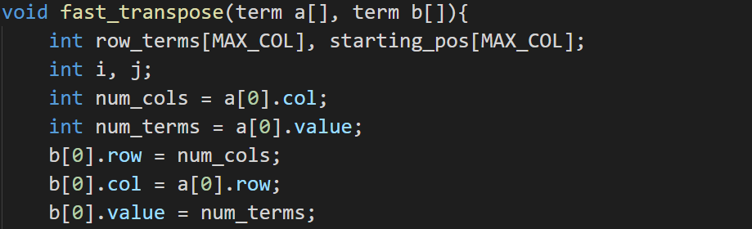
Fast transpose matrix
回outline
目的: 實作轉置矩陣
fast_transpose()程式碼說明:
透過a[0]的基本資料，知道轉置後的資本資料。
row, col: a的col轉置後是b的row
a的row轉置後是b的col
value: 轉置後的非0項目數量不變

Slide 47
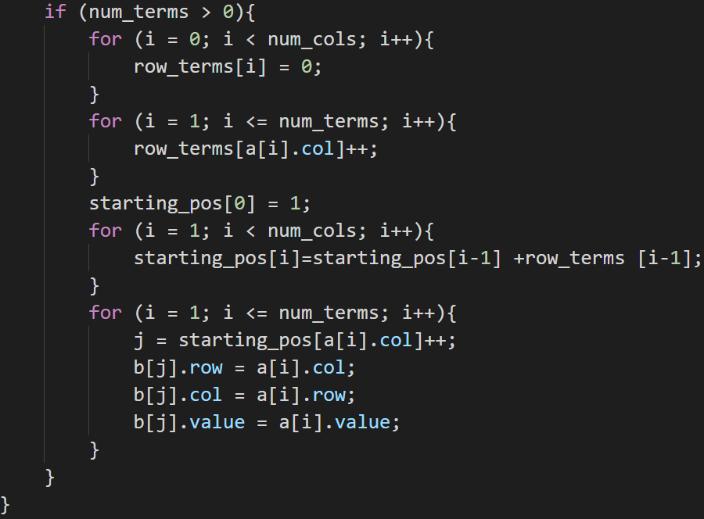
Fast transpose matrix
目的: 實作轉置矩陣
fast_transpose()程式碼說明:
row_terms
0
1
2
3
4
5
0
0
0
0
0
0

Slide 48
Fast transpose matrix
目的: 實作轉置矩陣
fast_transpose()程式碼說明:
i = 1
6 6 8
a[1].col
row_terms
0
1
2
3
4
5
1
0
0
0
0
0

Slide 49
Fast transpose matrix
目的: 實作轉置矩陣
fast_transpose()程式碼說明:
i = 2
6 6 8
a[2].col
row_terms
0
1
2
3
4
5
1
0
0
1
0
0

Slide 50
Fast transpose matrix
目的: 實作轉置矩陣
fast_transpose()程式碼說明:
i = 3
6 6 8
a[3].col
row_terms
0
1
2
3
4
5
1
0
0
1
0
1

Slide 51
Fast transpose matrix
目的: 實作轉置矩陣
fast_transpose()程式碼說明:
i = 4
6 6 8
a[4].col
row_terms
0
1
2
3
4
5
1
1
0
1
0
1

Slide 52
Fast transpose matrix
目的: 實作轉置矩陣
fast_transpose()程式碼說明:
i = 5
6 6 8
a[5].col
row_terms
0
1
2
3
4
5
1
1
1
1
0
1

Slide 53
Fast transpose matrix
目的: 實作轉置矩陣
fast_transpose()程式碼說明:
i = 6
6 6 8
a[6].col
row_terms
0
1
2
3
4
5
1
1
1
2
0
1

Slide 54
Fast transpose matrix
目的: 實作轉置矩陣
fast_transpose()程式碼說明:
i = 7
6 6 8
a[7].col
row_terms
0
1
2
3
4
5
2
1
1
2
0
1

Slide 55
Fast transpose matrix
目的: 實作轉置矩陣
fast_transpose()程式碼說明:
i = 8
6 6 8
a[8].col
row_terms
0
1
2
3
4
5
2
1
2
2
0
1

Slide 56
Fast transpose matrix
目的: 實作轉置矩陣
fast_transpose()程式碼說明:
i = 1
row_terms
0
1
2
3
4
5
2
1
2
2
0
1
starting_pos
0
1
2
3
4
5
1
3
starting_pos[1]=
starting_pos[0] + row_terms [0]

Slide 57
Fast transpose matrix
目的: 實作轉置矩陣
fast_transpose()程式碼說明:
i = 2
row_terms
0
1
2
3
4
5
2
1
2
2
0
1
starting_pos
0
1
2
3
4
5
1
3
4
starting_pos[2]=
starting_pos[1] + row_terms [1]

Slide 58
Fast transpose matrix
目的: 實作轉置矩陣
fast_transpose()程式碼說明:
i = 3
row_terms
0
1
2
3
4
5
2
1
2
2
0
1
starting_pos
0
1
2
3
4
5
1
3
4
6
starting_pos[3]=
starting_pos[2] + row_terms [2]

Slide 59
Fast transpose matrix
目的: 實作轉置矩陣
fast_transpose()程式碼說明:
i = 4
row_terms
0
1
2
3
4
5
2
1
2
2
0
1
starting_pos
0
1
2
3
4
5
1
3
4
6
8
starting_pos[4]=
starting_pos[3] + row_terms [3]

Slide 60
Fast transpose matrix
目的: 實作轉置矩陣
fast_transpose()程式碼說明:
i = 5
row_terms
0
1
2
3
4
5
2
1
2
2
0
1
starting_pos
0
1
2
3
4
5
1
3
4
6
8
8
starting_pos[5]=
starting_pos[4] + row_terms [4]

Slide 61
Fast transpose matrix
目的: 實作轉置矩陣
6 6 8
a[1].col
fast_transpose()程式碼說明:
i = 1
starting_pos
0
1
2
3
4
5
1
3
4
6
8
8

Slide 62
Fast transpose matrix
目的: 實作轉置矩陣
6 6 8
a[2].col
fast_transpose()程式碼說明:
i = 2
starting_pos
0
1
2
3
4
5
1
3
4
6
8
8

Slide 63
Fast transpose matrix
目的: 實作轉置矩陣
6 6 8
a[3].col
fast_transpose()程式碼說明:
i = 3
starting_pos
0
1
2
3
4
5
1
3
4
6
8
8

Slide 64
Fast transpose matrix
目的: 實作轉置矩陣
6 6 8
a[4].col
fast_transpose()程式碼說明:
i = 4
starting_pos
0
1
2
3
4
5
1
3
4
6
8
8

Slide 65
Fast transpose matrix
目的: 實作轉置矩陣
6 6 8
a[5].col
fast_transpose()程式碼說明:
i = 5
starting_pos
0
1
2
3
4
5
1
3
4
6
8
8

Slide 66
Fast transpose matrix
目的: 實作轉置矩陣
6 6 8
a[6].col
fast_transpose()程式碼說明:
i = 6
starting_pos
0
1
2
3
4
5
1
3
4
6
8
8

Slide 67
Fast transpose matrix
目的: 實作轉置矩陣
6 6 8
a[7].col
fast_transpose()程式碼說明:
i = 7
starting_pos
0
1
2
3
4
5
1
3
4
6
8
8

Slide 68
Fast transpose matrix
回outline
目的: 實作轉置矩陣
6 6 8
a[8].col
fast_transpose()程式碼說明:
i = 8
starting_pos
0
1
2
3
4
5
1
3
4
6
8
8

Slide 69


Sparse Matrix Multiplication
回outline
目的: 實作稀疏矩陣a*矩陣b=矩陣d
做法說明:
a
$$\left[\begin{matrix}1 & 0 & 0 \\ 2 & 0 & 0 \\ 3 & 0 & 0\end{matrix}\right]$$
6 6 8
3 3
0 0 1
1 0 2
2 0 3
b
$$\left[\begin{matrix}1 & 2 & 3 \\ 0 & 0 & 0 \\ 0 & 0 & 0\end{matrix}\right]$$
6 6 8
3 3
0 0 1
0 1 2
0 2 3
6 6 8
newB
3 3
0 0 1
1 0 2
2 0 3
transpose

Slide 70
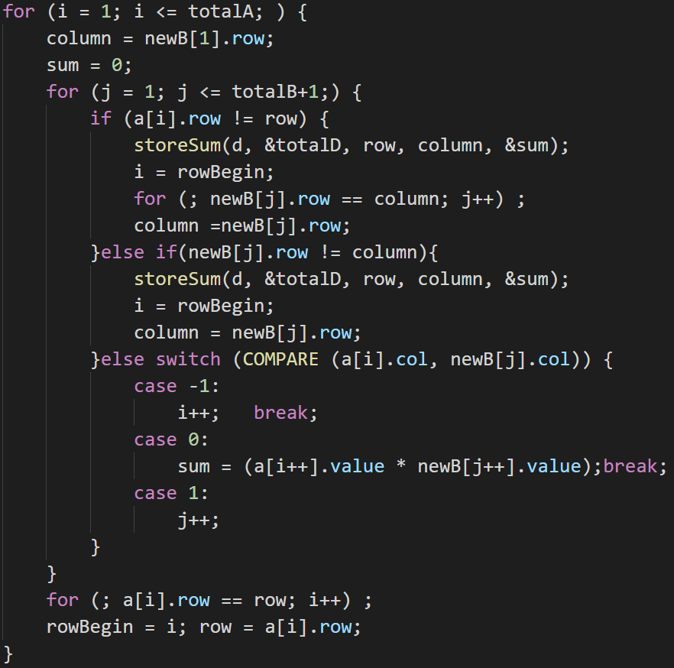
initial
rowsA=a[0].row=3 colsB=b[0].col=3
colsA=a[0].col=3
totalA=a[0].value=3 totalB=b[0].value=3
row=a[1].row=0
6 6 8
3 3 3
0 0 1
1 0 2
2 0 3
[4] 3 0 0
3 3 3
0 0 1
1 0 2
2 0 3
[4] 3 0 0
newB
6 6 8
i = 1, j = 1, rowBegin = 1, column = 0
a[i].row=0, row=0
=> False

Slide 71
initial
rowsA=a[0].row=3 colsB=b[0].col=3
colsA=a[0].col=3
totalA=a[0].value=3 totalB=b[0].value=3
row=a[1].row=0
6 6 8
3 3 3
0 0 1
1 0 2
2 0 3
[4] 3 0 0
3 3 3
0 0 1
1 0 2
2 0 3
[4] 3 0 0
newB
6 6 8
i = 1, j = 1, rowBegin = 1, column = 0
newB[j].row=0, column=0
=> False

Slide 72
initial
rowsA=a[0].row=3 colsB=b[0].col=3
colsA=a[0].col=3
totalA=a[0].value=3 totalB=b[0].value=3
row=a[1].row=0
6 6 8
3 3 3
0 0 1
1 0 2
2 0 3
[4] 3 0 0
3 3 3
0 0 1
1 0 2
2 0 3
[4] 3 0 0
newB
6 6 8
i = 1, j = 1, rowBegin = 1, column = 0
a[1].col=0 = newB[1].col=0 => case 0

Slide 73
initial
rowsA=a[0].row=3 colsB=b[0].col=3
colsA=a[0].col=3
totalA=a[0].value=3 totalB=b[0].value=3
row=a[1].row=0
6 6 8
3 3 3
0 0 1
1 0 2
2 0 3
[4] 3 0 0
3 3 3
0 0 1
1 0 2
2 0 3
[4] 3 0 0
newB
6 6 8
i = 1, j = 1, rowBegin = 1, column = 0
a[i++].value=1
newB[j++].value=1
sum=1 i=2 j=2

Slide 74
initial
rowsA=a[0].row=3 colsB=b[0].col=3
colsA=a[0].col=3
totalA=a[0].value=3 totalB=b[0].value=3
row=a[1].row=0
6 6 8
3 3 3
0 0 1
1 0 2
2 0 3
[4] 3 0 0
3 3 3
0 0 1
1 0 2
2 0 3
[4] 3 0 0
newB
6 6 8
i = 2, j = 2, rowBegin = 1, column = 0
a[2].row=1 != row=0
=> True

Slide 75
initial
rowsA=a[0].row=3 colsB=b[0].col=3
colsA=a[0].col=3
totalA=a[0].value=3 totalB=b[0].value=3
row=a[1].row=0
6 6 8
3 3 3
0 0 1
1 0 2
2 0 3
[4] 3 0 0
3 3 3
0 0 1
1 0 2
2 0 3
[4] 3 0 0
newB
6 6 8
i = 2, j = 2, rowBegin = 1, column = 0
[0] 0 0 0
[1] 0 0 1
[2]
[3]
[4]
[5]
[6]
[7]
[8]
[9]
d
6 6 8

Slide 76
initial
rowsA=a[0].row=3 colsB=b[0].col=3
colsA=a[0].col=3
totalA=a[0].value=3 totalB=b[0].value=3
row=a[1].row=0
6 6 8
3 3 3
0 0 1
1 0 2
2 0 3
[4] 3 0 0
3 3 3
0 0 1
1 0 2
2 0 3
[4] 3 0 0
newB
6 6 8
i = 2, j = 2, rowBegin = 1, column = 0
i=1 j=2 column=1

Slide 77
initial
rowsA=a[0].row=3 colsB=b[0].col=3
colsA=a[0].col=3
totalA=a[0].value=3 totalB=b[0].value=3
row=a[1].row=0
6 6 8
3 3 3
0 0 1
1 0 2
2 0 3
[4] 3 0 0
3 3 3
0 0 1
1 0 2
2 0 3
[4] 3 0 0
newB
6 6 8
i = 1, j = 2, rowBegin = 1, column = 1
a[1].row=0, row=0
=> False

Slide 78
initial
rowsA=a[0].row=3 colsB=b[0].col=3
colsA=a[0].col=3
totalA=a[0].value=3 totalB=b[0].value=3
row=a[1].row=0
6 6 8
3 3 3
0 0 1
1 0 2
2 0 3
[4] 3 0 0
3 3 3
0 0 1
1 0 2
2 0 3
[4] 3 0 0
newB
6 6 8
i = 1, j = 2, rowBegin = 1, column = 1
newB[j].row=1, column=1
=> False

Slide 79
initial
rowsA=a[0].row=3 colsB=b[0].col=3
colsA=a[0].col=3
totalA=a[0].value=3 totalB=b[0].value=3
row=a[1].row=0
6 6 8
3 3 3
0 0 1
1 0 2
2 0 3
[4] 3 0 0
3 3 3
0 0 1
1 0 2
2 0 3
[4] 3 0 0
newB
6 6 8
i = 1, j = 2, rowBegin = 1, column = 1
a[1].col=0 = newB[2].col=0 => case 0

Slide 80
initial
rowsA=a[0].row=3 colsB=b[0].col=3
colsA=a[0].col=3
totalA=a[0].value=3 totalB=b[0].value=3
row=a[1].row=0
6 6 8
3 3 3
0 0 1
1 0 2
2 0 3
[4] 3 0 0
3 3 3
0 0 1
1 0 2
2 0 3
[4] 3 0 0
newB
6 6 8
i = 1, j = 2, rowBegin = 1, column = 1
a[i++].value=1
newB[j++].value=2
sum=2 i=2 j=3

Slide 81
initial
rowsA=a[0].row=3 colsB=b[0].col=3
colsA=a[0].col=3
totalA=a[0].value=3 totalB=b[0].value=3
row=a[1].row=0
6 6 8
3 3 3
0 0 1
1 0 2
2 0 3
[4] 3 0 0
3 3 3
0 0 1
1 0 2
2 0 3
[4] 3 0 0
newB
6 6 8
i = 2, j = 3, rowBegin = 1, column = 1
a[2].row=1, row=0
=> True

Slide 82
initial
rowsA=a[0].row=3 colsB=b[0].col=3
colsA=a[0].col=3
totalA=a[0].value=3 totalB=b[0].value=3
row=a[1].row=0
6 6 8
3 3 3
0 0 1
1 0 2
2 0 3
[4] 3 0 0
3 3 3
0 0 1
1 0 2
2 0 3
[4] 3 0 0
newB
6 6 8
i = 2, j = 3, rowBegin = 1, column = 1
[0] 0 0 0
[1] 0 0 1
[2] 0 1 2
[3]
[4]
[5]
[6]
[7]
[8]
[9]
d
6 6 8

Slide 83
initial
rowsA=a[0].row=3 colsB=b[0].col=3
colsA=a[0].col=3
totalA=a[0].value=3 totalB=b[0].value=3
row=a[1].row=0
6 6 8
3 3 3
0 0 1
1 0 2
2 0 3
[4] 3 0 0
3 3 3
0 0 1
1 0 2
2 0 3
[4] 3 0 0
newB
6 6 8
i = 2, j = 3, rowBegin = 1, column = 1
i=1 j=3 column=2

Slide 84
initial
rowsA=a[0].row=3 colsB=b[0].col=3
colsA=a[0].col=3
totalA=a[0].value=3 totalB=b[0].value=3
row=a[1].row=0
6 6 8
3 3 3
0 0 1
1 0 2
2 0 3
[4] 3 0 0
3 3 3
0 0 1
1 0 2
2 0 3
[4] 3 0 0
newB
6 6 8
i = 1, j = 3, rowBegin = 1, column = 2
a[1].row=0, row=0
=> False

Slide 85
initial
rowsA=a[0].row=3 colsB=b[0].col=3
colsA=a[0].col=3
totalA=a[0].value=3 totalB=b[0].value=3
row=a[1].row=0
6 6 8
3 3 3
0 0 1
1 0 2
2 0 3
[4] 3 0 0
3 3 3
0 0 1
1 0 2
2 0 3
[4] 3 0 0
newB
6 6 8
i = 1, j = 3, rowBegin = 1, column = 2
newB[j].row=2, column=2
=> False

Slide 86
initial
rowsA=a[0].row=3 colsB=b[0].col=3
colsA=a[0].col=3
totalA=a[0].value=3 totalB=b[0].value=3
row=a[1].row=0
6 6 8
3 3 3
0 0 1
1 0 2
2 0 3
[4] 3 0 0
3 3 3
0 0 1
1 0 2
2 0 3
[4] 3 0 0
newB
6 6 8
i = 1, j = 3, rowBegin = 1, column = 2
a[1].col=0 = newB[3].col=0 => case 0

Slide 87
initial
rowsA=a[0].row=3 colsB=b[0].col=3
colsA=a[0].col=3
totalA=a[0].value=3 totalB=b[0].value=3
row=a[1].row=0
6 6 8
3 3 3
0 0 1
1 0 2
2 0 3
[4] 3 0 0
3 3 3
0 0 1
1 0 2
2 0 3
[4] 3 0 0
newB
6 6 8
i = 1, j = 3, rowBegin = 1, column = 2
a[i++].value=1
newB[j++].value=3
sum=3 i=2 j=4

Slide 88
initial
rowsA=a[0].row=3 colsB=b[0].col=3
colsA=a[0].col=3
totalA=a[0].value=3 totalB=b[0].value=3
row=a[1].row=0
6 6 8
3 3 3
0 0 1
1 0 2
2 0 3
[4] 3 0 0
3 3 3
0 0 1
1 0 2
2 0 3
[4] 3 0 0
newB
6 6 8
i = 2, j = 4, rowBegin = 1, column = 2
a[2].row=1, row=0
=> True

Slide 89
initial
rowsA=a[0].row=3 colsB=b[0].col=3
colsA=a[0].col=3
totalA=a[0].value=3 totalB=b[0].value=3
row=a[1].row=0
6 6 8
3 3 3
0 0 1
1 0 2
2 0 3
[4] 3 0 0
3 3 3
0 0 1
1 0 2
2 0 3
[4] 3 0 0
newB
6 6 8
i = 2, j = 4, rowBegin = 1, column = 2
[0] 0 0 0
[1] 0 0 1
[2] 0 1 2
[3] 0 2 3
[4]
[5]
[6]
[7]
[8]
[9]
d
6 6 8

Slide 90
initial
rowsA=a[0].row=3 colsB=b[0].col=3
colsA=a[0].col=3
totalA=a[0].value=3 totalB=b[0].value=3
row=a[1].row=0
6 6 8
3 3 3
0 0 1
1 0 2
2 0 3
[4] 3 0 0
3 3 3
0 0 1
1 0 2
2 0 3
[4] 3 0 0
newB
6 6 8
i = 2, j = 4, rowBegin = 1, column = 2
i=1 j=4 column=3

Slide 91
initial
rowsA=a[0].row=3 colsB=b[0].col=3
colsA=a[0].col=3
totalA=a[0].value=3 totalB=b[0].value=3
row=a[1].row=0
6 6 8
3 3 3
0 0 1
1 0 2
2 0 3
[4] 3 0 0
3 3 3
0 0 1
1 0 2
2 0 3
[4] 3 0 0
newB
6 6 8
i = 1, j = 4, rowBegin = 1, column = 3
a[1].row=0, row=0
=> False

Slide 92
initial
rowsA=a[0].row=3 colsB=b[0].col=3
colsA=a[0].col=3
totalA=a[0].value=3 totalB=b[0].value=3
row=a[1].row=0
6 6 8
3 3 3
0 0 1
1 0 2
2 0 3
[4] 3 0 0
3 3 3
0 0 1
1 0 2
2 0 3
[4] 3 0 0
newB
6 6 8
i = 1, j = 4, rowBegin = 1, column = 3
newB[j].row=3, column=3
=> False

Slide 93
initial
rowsA=a[0].row=3 colsB=b[0].col=3
colsA=a[0].col=3
totalA=a[0].value=3 totalB=b[0].value=3
row=a[1].row=0
6 6 8
3 3 3
0 0 1
1 0 2
2 0 3
[4] 3 0 0
3 3 3
0 0 1
1 0 2
2 0 3
[4] 3 0 0
newB
6 6 8
i = 1, j = 4, rowBegin = 1, column = 3
a[1].col=0 = newB[4].col=0 => case 0

Slide 94
initial
rowsA=a[0].row=3 colsB=b[0].col=3
colsA=a[0].col=3
totalA=a[0].value=3 totalB=b[0].value=3
row=a[1].row=0
6 6 8
3 3 3
0 0 1
1 0 2
2 0 3
[4] 3 0 0
3 3 3
0 0 1
1 0 2
2 0 3
[4] 3 0 0
newB
6 6 8
i = 1, j = 4, rowBegin = 1, column = 3
a[i++].value=1
newB[j++].value=0
sum=0 i=2 j=5

Slide 95
initial
rowsA=a[0].row=3 colsB=b[0].col=3
colsA=a[0].col=3
totalA=a[0].value=3 totalB=b[0].value=3
row=a[1].row=0
回outline
6 6 8
3 3 3
0 0 1
1 0 2
2 0 3
[4] 3 0 0
3 3 3
0 0 1
1 0 2
2 0 3
[4] 3 0 0
newB
6 6 8
i = 1, j = 4, rowBegin = 1, column = 3
以此類推
i=2 rowBegin=2 row=1

